Slide 1
Reproducible Research in Secondary Data Analysis
Abraham D Flaxman
November 18, 2014

Slide 2
Outline
Reproducible research
Secondary data analysis
Doing Both Together
Reproducible secondary data
Reproducible data analysis

Slide 3
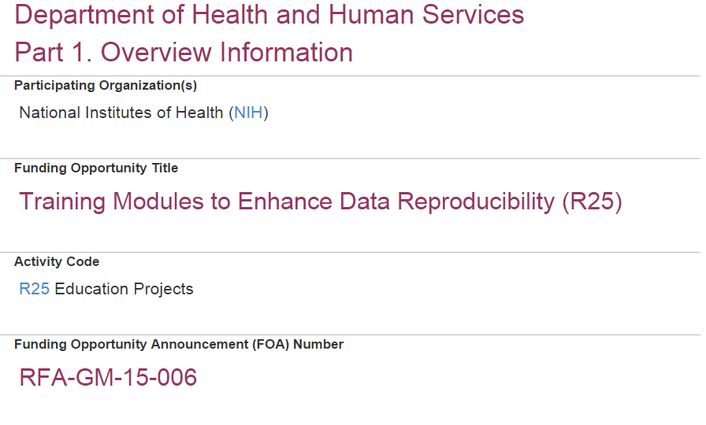
Notes:
RFP inspiration: I’ve had fun thinking about this on the RRWG mailing list (all on it?), but I was motivated to get my thoughts in order when NIH released an RFP for an R25 in reproducibility.
http://grants.nih.gov/grants/guide/rfa-files/RFA-GM-15-006.html

Slide 4
Outline
Reproducible research
Secondary data analysis
Doing Both Together
Reproducible secondary data
Reproducible data analysis

Slide 5
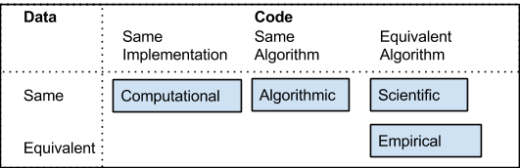
Reproducible research
What is reproducibility?
Why? At least 4 reasons…
Notes:
Credibility through allowing verification of results; make full results publicly available; enable others to ask new questions; facilitate the advance of scientific knowledge (is that really different than enable others?)

Slide 6
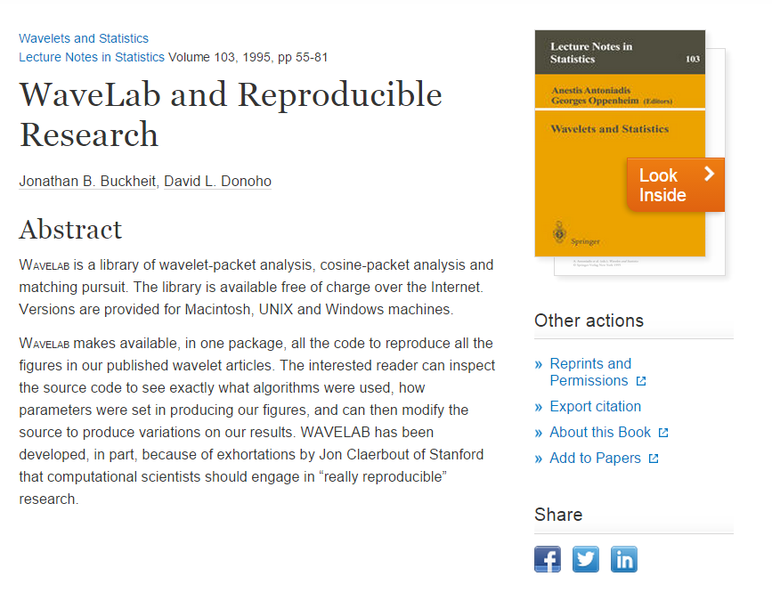

Slide 7
Outline
Reproducible research
Secondary data analysis
Doing Both Together
Reproducible secondary data
Reproducible data analysis

Slide 8
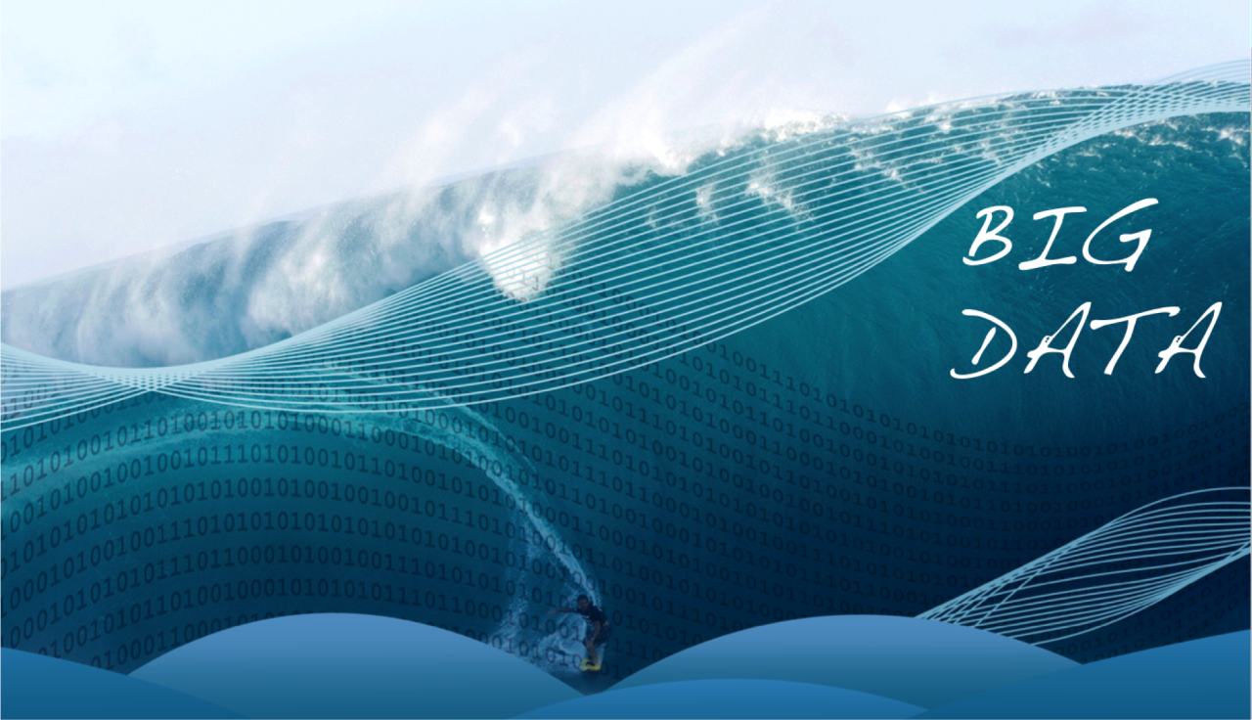
Notes:
From http://bigdatapix.tumblr.com/
Pictures of Big Data
Big Data is visualized in so many ways...all of them blue and with numbers and lens flare.

Slide 9

Notes:
Cool even in the 1980s, though.

Slide 10
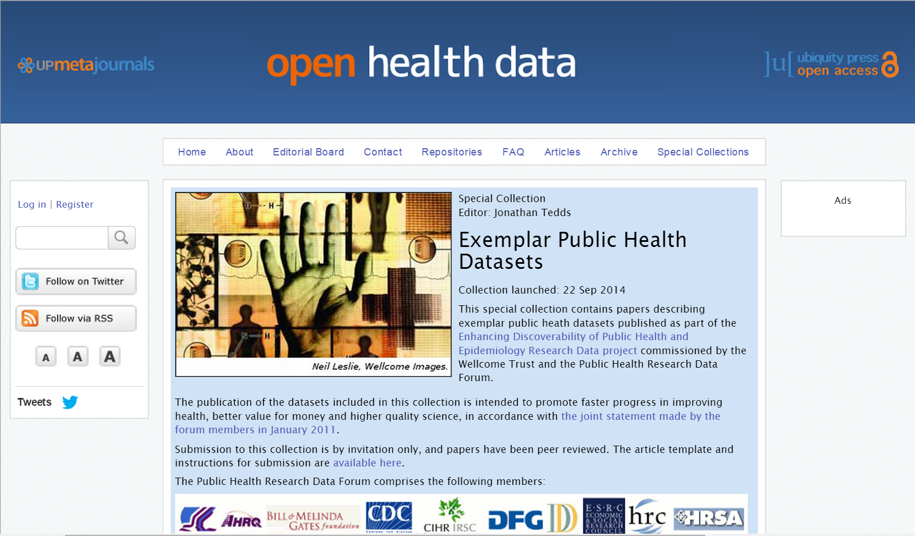
Notes:
Shame by category, praise by example

Slide 11
What is data?
We may all come up with a different definition if we were to try to write one today, but “I know it when I see it.”
(Insufficient) Math Definition:

Slide 12
What is secondary data analysis?
In short:
any analysis where the data was collected by someone other than the analyst.

Slide 13
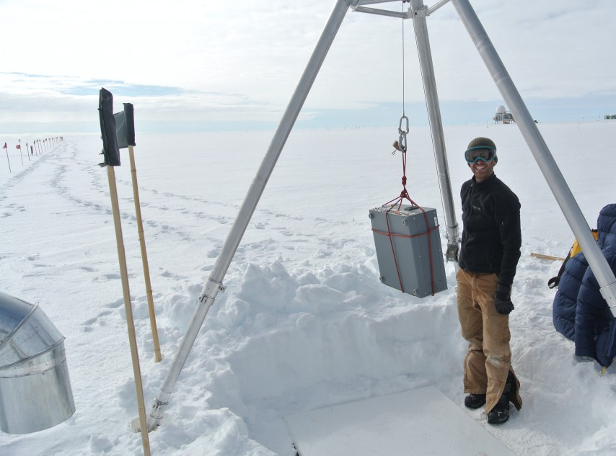
Notes:
What is not secondary data analysis? If you have to go to the north pole with a box that takes measurements, you are probably doing “primary data collection”.

Slide 14
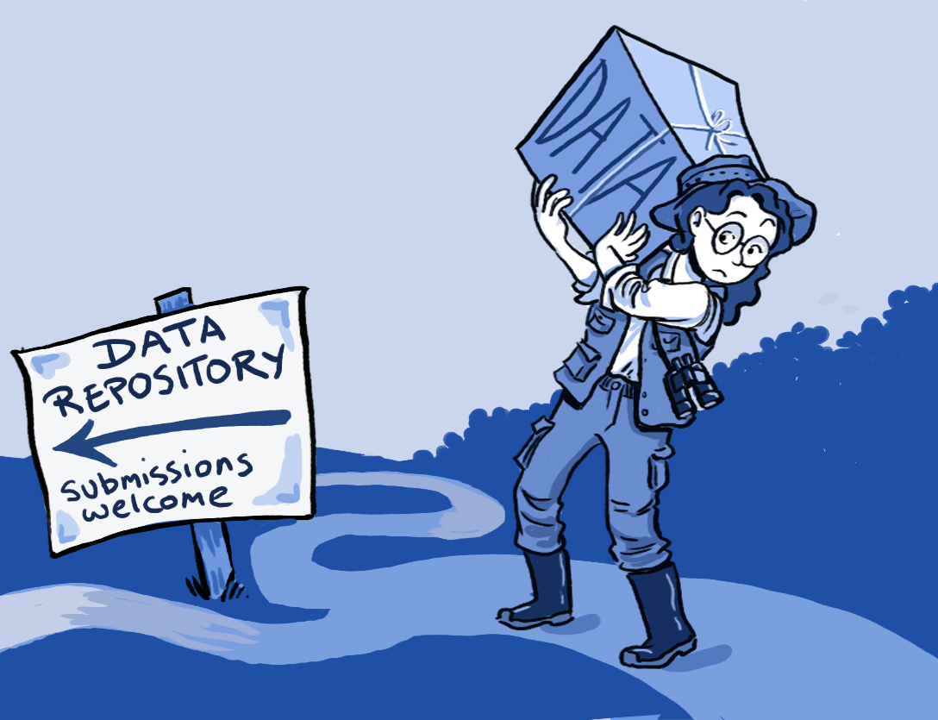
Notes:
Secondary data analysis is becoming more and more feasible/appealing
To deposit or not to deposit, that is the question - journal.pbio.1001779.g001CC BY 4.0
Roche DG, Lanfear R, Binning SA, Haff TM, Schwanz LE, et al. (2014) - Roche DG, Lanfear R, Binning SA, Haff TM, Schwanz LE, et al. (2014) Troubleshooting Public Data Archiving: Suggestions to Increas…

Slide 15
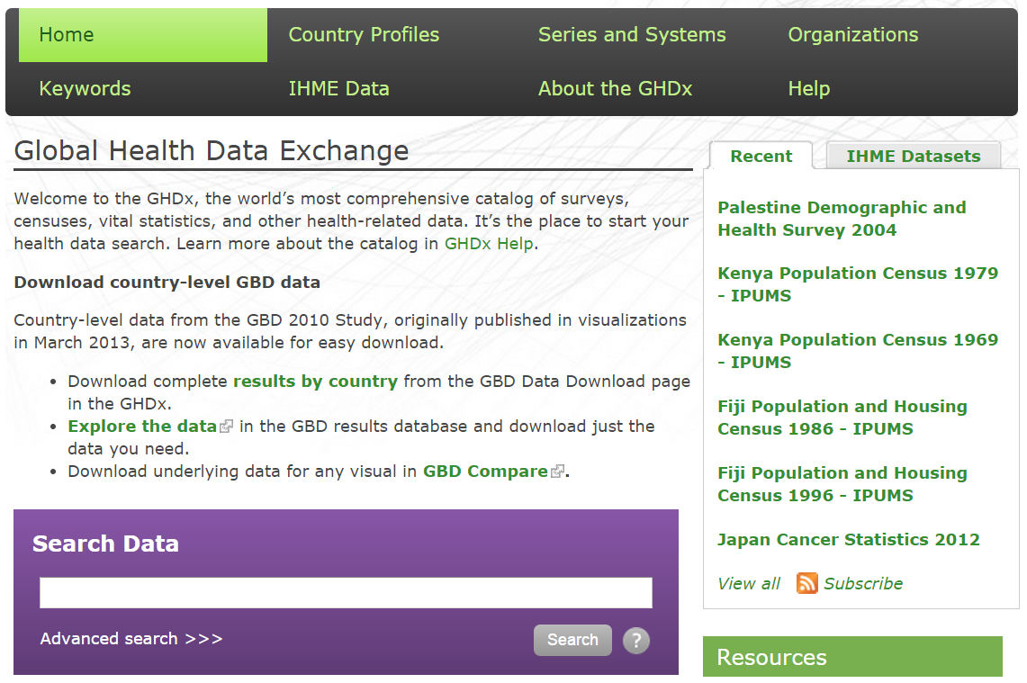

Slide 16
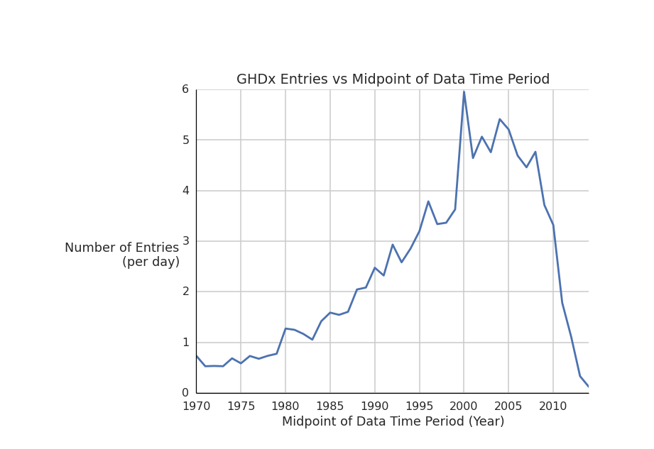

Slide 17
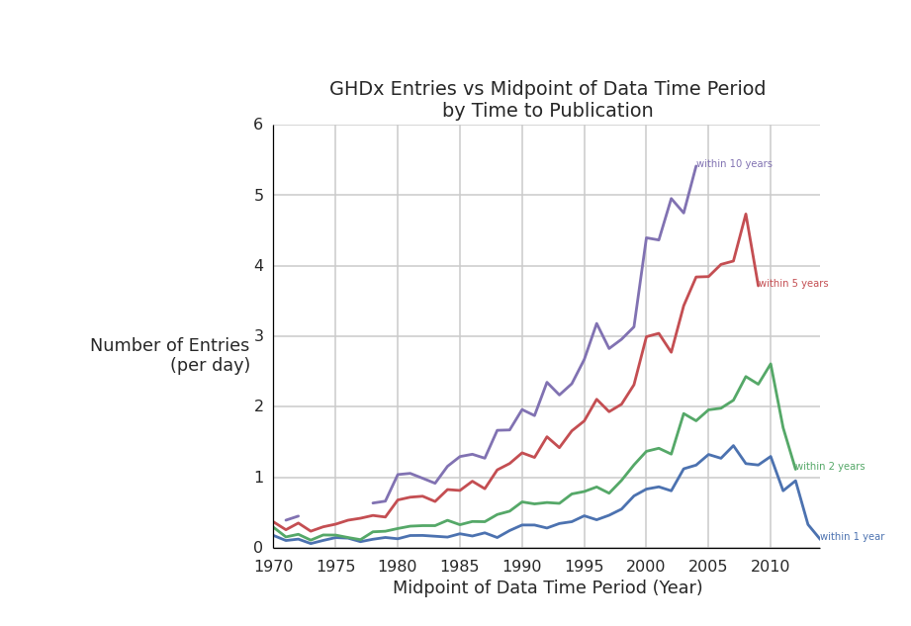

Slide 18
Outline
Reproducible research
Secondary data analysis
Doing Both Together
Reproducible secondary data
Reproducible data analysis

Slide 19
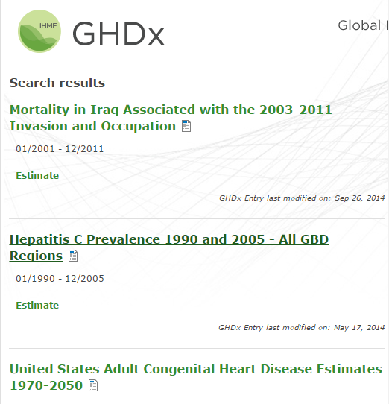

Slide 20
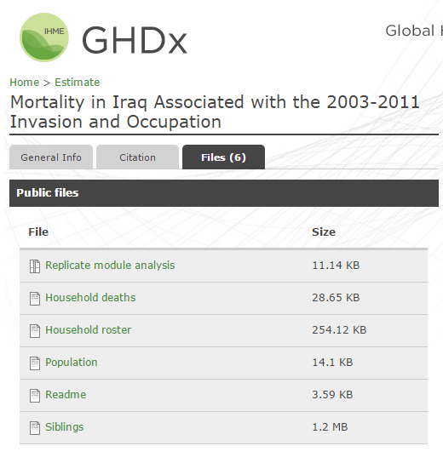

Slide 21
Outline
Reproducible research
Secondary data analysis
Doing Both Together
Reproducible secondary data
Reproducible data analysis

Slide 22
Things I want my students to do (1)
Making secondary data reproducible:
Documenting search strategy
Capturing essential information (meta-data)
Data cleaning
Double entry/spot checking

Slide 23
Example of a search strategy:
("adult congenital heart disease") AND (prevalence OR mortality) AND ("1980/01/01"[Date - Completion] : "2014/01/01"[Date - Completion])

Slide 24
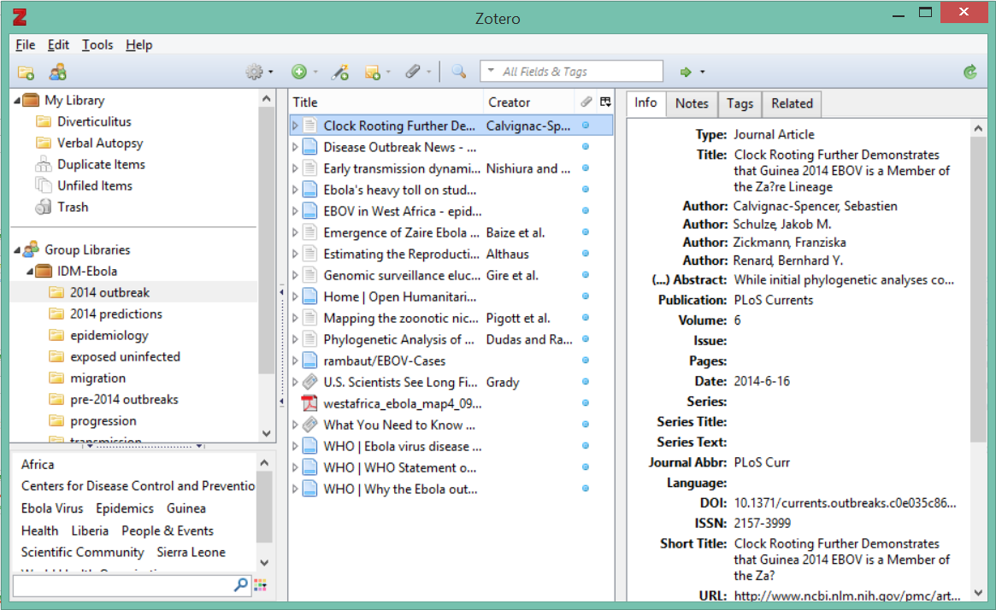
Example of systematic review meta-data

Slide 25
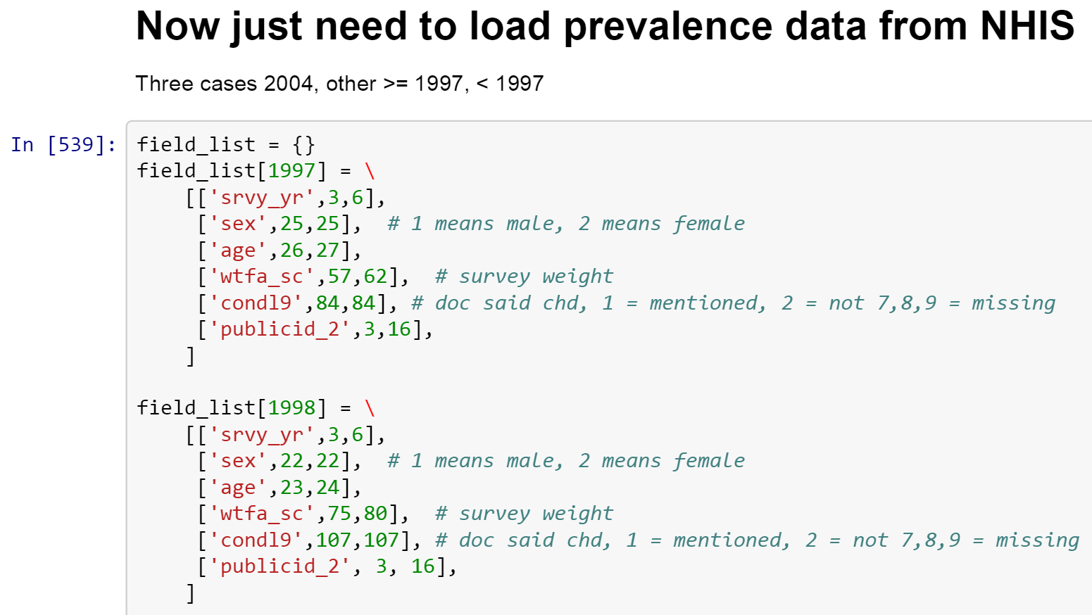
Example of data cleaning code

Slide 26
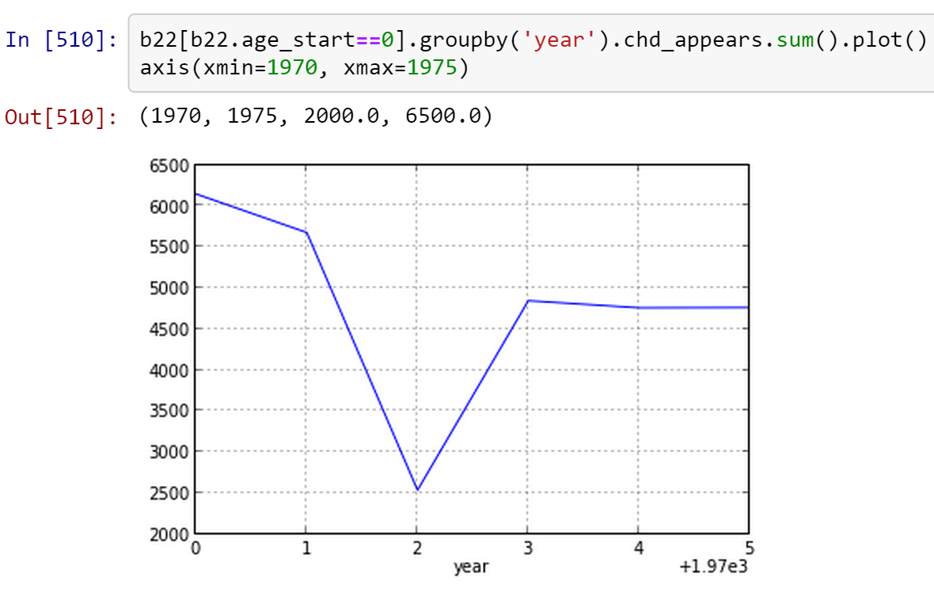
Example of spot checking

Slide 27
Outline
Reproducible research
Secondary data analysis
Doing Both Together
Reproducible secondary data
Reproducible data analysis

Slide 28
Things I want my students to know (2)
Making analysis reproducible:
Literate programming
Test-driven development
Version control
Code review

Slide 29

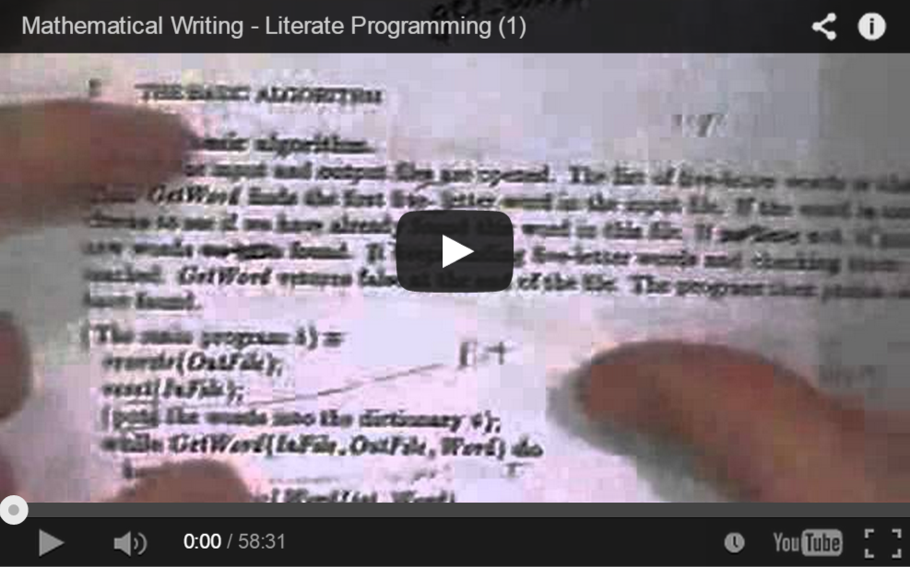
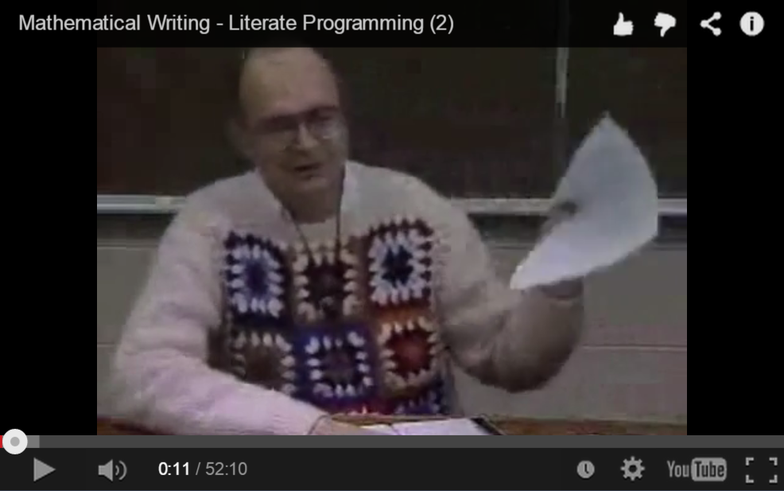
Notes:
http://commons.wikimedia.org/wiki/File:Test-driven_development.PNG
http://en.wikipedia.org/wiki/Test-driven_development

Slide 30
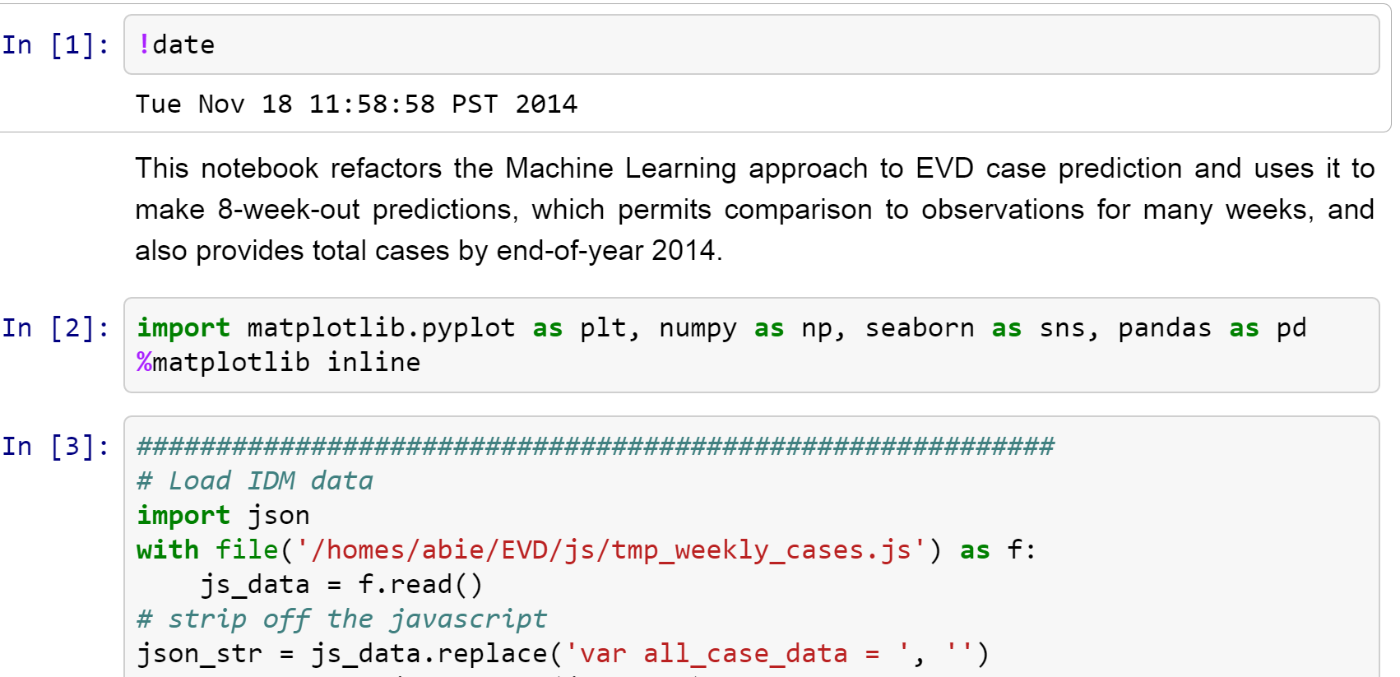
Literate programming can be easy

Slide 31
Test-driven development
write test
fail
write code
pass

Slide 32
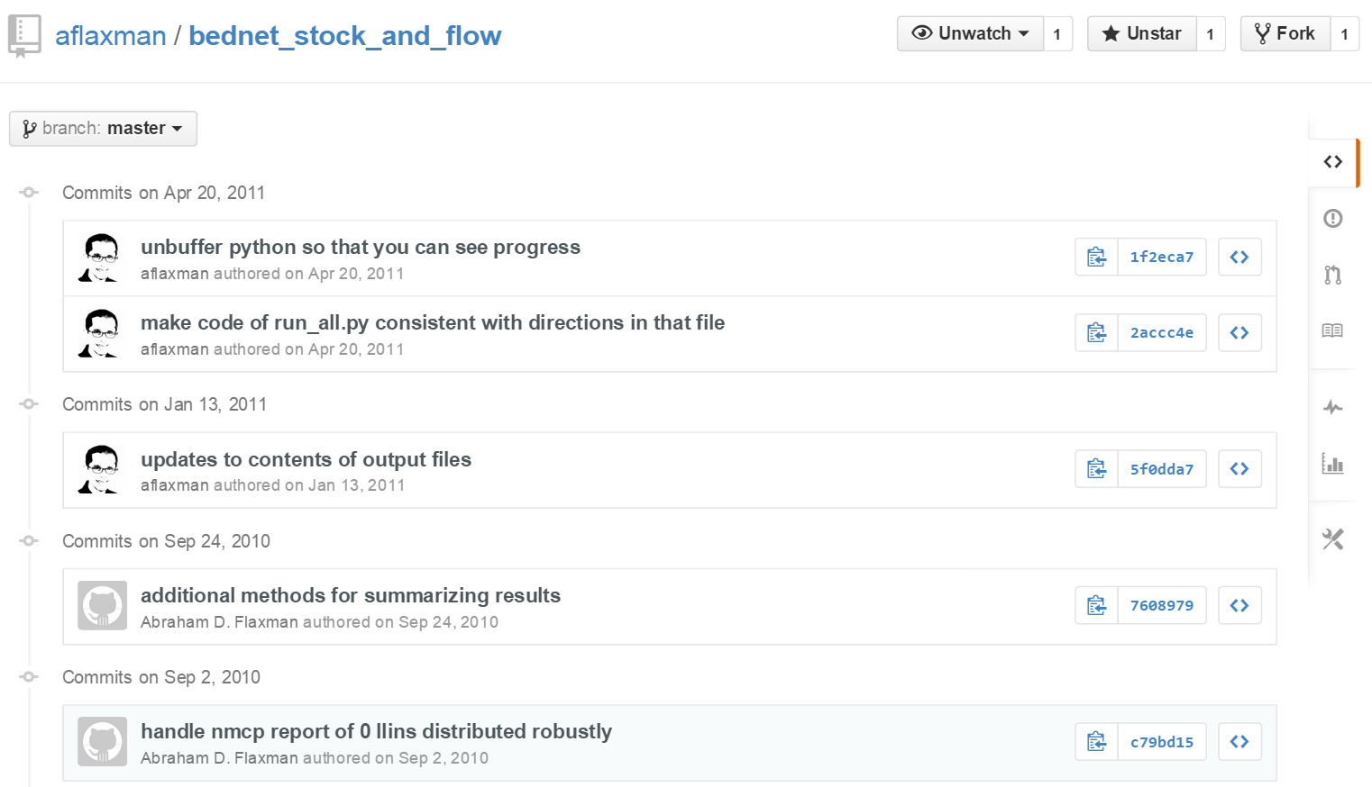
Example of revision control

Slide 33
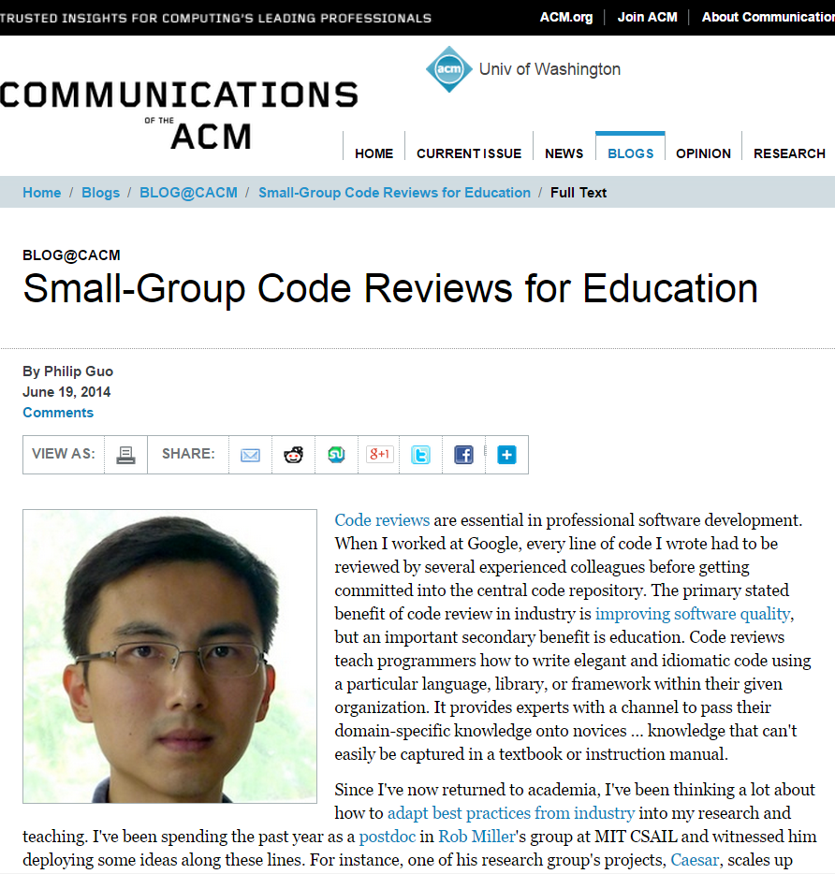

Slide 34
Outline
Reproducible research
Secondary data analysis
Doing Both Together
Reproducible secondary data
Reproducible data analysis
Feedback welcome!

